Slide 15
Notes:
Bradley

Slide 16
Notes:
Central Methodist

Slide 17
Notes:
Drury

Slide 18
Illinois Wesleyan University
Milt Berwin
www.iwu.edu/admissions

Slide 19
Notes:
K-State

Slide 20
Notes:
Millikin

Slide 22
Notes:
Missouri State

Slide 23
Notes:
MO S&T

Slide 24
Notes:
Murray State

Slide 26
Notes:
Southeast MO State

Slide 27
Notes:
SIU-Carbondale

Slide 28
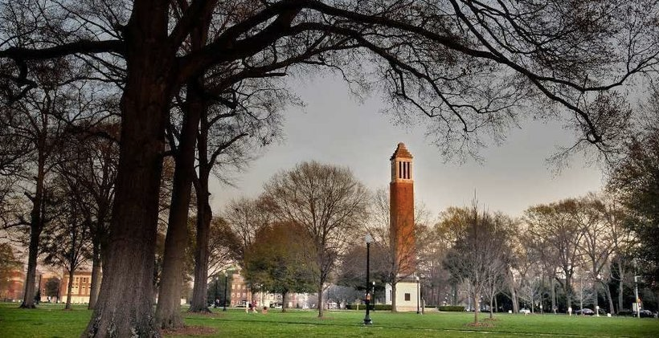
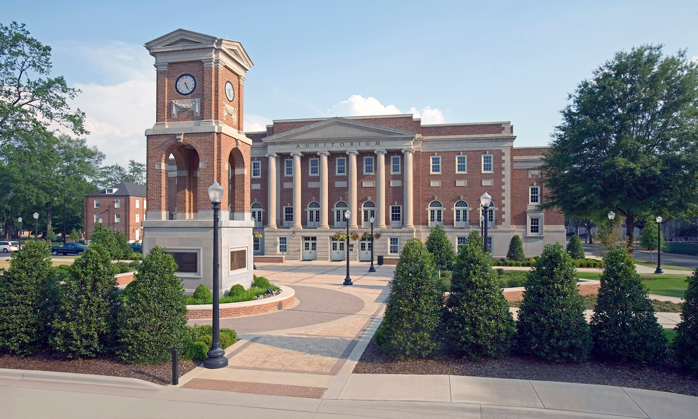
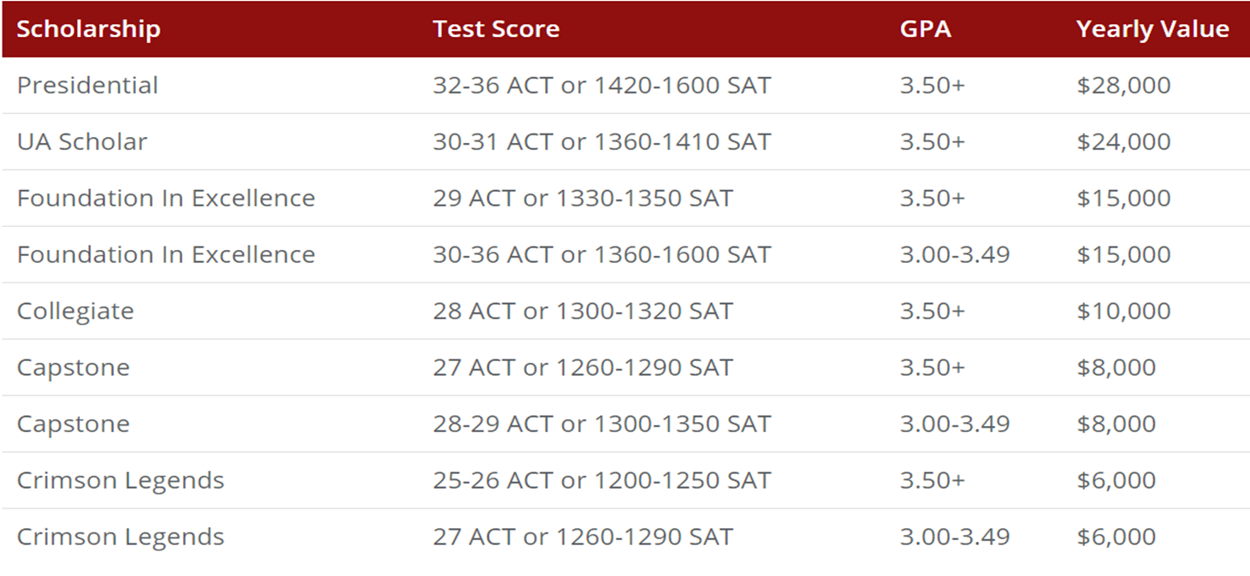
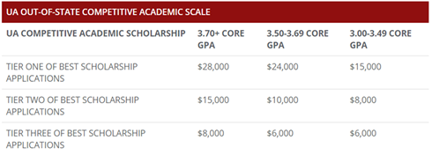
37,842 Total Enrollment
200+ Areas of Study and 7 Honors Programs
58% Out-of-State Enrollment
#1 in the SEC and #2 in the nation for internship placement
January 15th scholarship app priority deadline!
Fall 2020 Freshman Class
3.83 Avg. GPA
39.9% scored 30 or higher ACT
221 National Merit Scholars
Amanda Sisk
Regional Recruiter for
MO, KS, and Southern IL
amanda.bama@ua.edu
314-610-7493
Automatic Merit Scholarships
Competitive academic scholarships (based on core GPA and scholarship application)

Slide 29
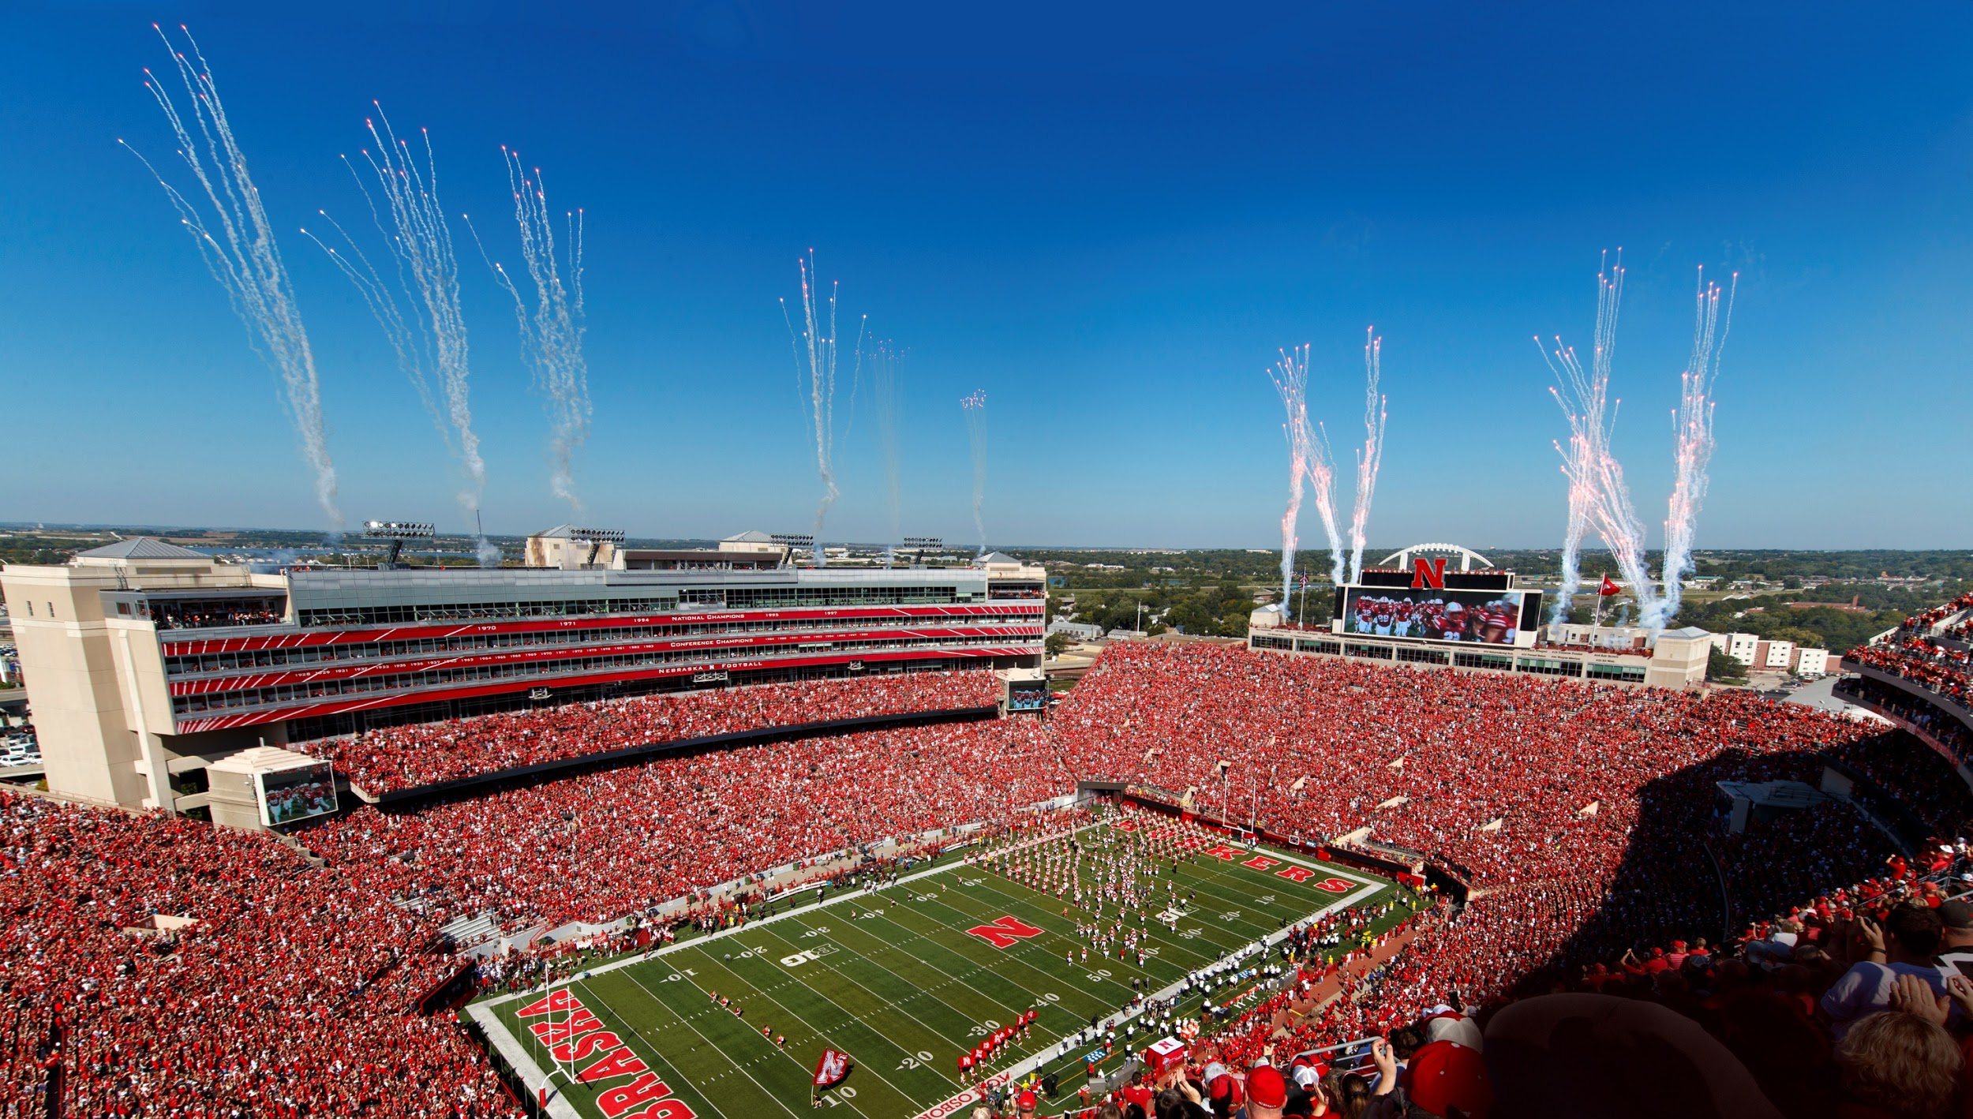
20,830 150+ Majors Smallest B1G
Undergraduates 600+ Organizations Public School
► Tuition/Fees: $25,896 » New 3.0 cumulative HS GPA will satisfy
Room/Board: $11,830 performance requirement for admission (test scores still necessary for scholarships)
► $13k/year - Average Merit Scholarship
» Institutional, Common & Coalition App
► Business, Engineering, Education Self-report academic information
and Journalism – Top Colleges
» $160 million in enhancements + new facility
► Test flexible for admission & scholarships for College of Engineering opening 2022/2023
» New $47 million facility for College of Education Email: admissions@unl.edu and Human Sciences opening Fall 2022
Website: Admissions.unl.edu
Notes:
Nebraska

Slide 30
Notes:
Tulsa

Slide 31
Notes:
Truman

Slide 32
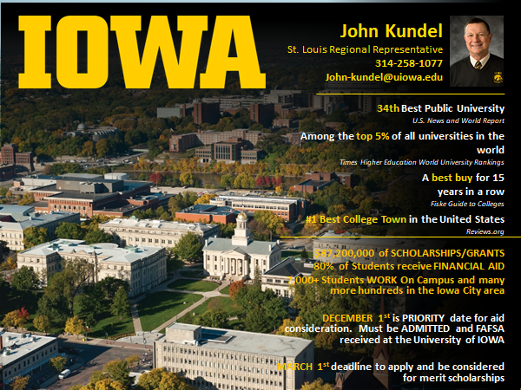
Notes:
Iowa

Slide 33
Notes:
KU

Slide 34
Notes:
Kentucky

Slide 35
Notes:
Memphis

Slide 36
Notes:
Mizzou

Slide 37
Notes:
Western Illinois

Slide 38
Notes:
Westminster

Slide 39
Notes:
William Woods

